Slide 1
EMS Interoperability Task Force September 14, 2023
Hospital-to-EMS Outcome Information Flow
Notes:
This meeting is being recorded and will be posted. If you need anything removed from the recording, let us know.
Note change to moderated format, use hand raise feature to be acknowledged to speak.

Slide 2
Task Force Overview
Monthly, 2nd Thursday, 11a–12:30p MT
Oct 12, Nov 9, Dec 14 Dec 15 (ONC Annual Meeting / EMS Data Summit)
Topics:
Feb 16: Identifying data exchange partners and establishing relationships
Mar 9: Governmental, regulatory, and contractual environment
Apr 13: Regulatory environment and national networks recap
May 11: Sequence/workflow: SAFR design
Jun 8: Sequence/workflow
Jul 13: Standards and profiles overview
Specific standards and profiles to use in workflow:
Aug 10: EMS to Hospital
Sep 14: Hospital Outcomes to EMS
Patient History to EMS
Patient identification and record matching
Data elements to be shared and parsed
APIs

Slide 3


ONC Annual Meeting & EMS Data Summit
ONC Annual Meeting
EMS Data Summit
December 14–15, 2023
Washington DC
ONCannualmeeting.com
December 15, 12:00–3:30p ET
Washington DC and online
umarket.utah.edu/um2/nemsis
Notes:
https://www.oncannualmeeting.com/
https://umarket.utah.edu/um2/nemsis/

Slide 4
EMS Data Summit
This Summit will pick up with lessons learned from the 2020 EMS Data Summit and focus on improving the integration of standardized emergency medical services (EMS) data with hospital electronic medical records (EMRs) and health information exchanges (HIEs).
Perspectives from:
Prehospital
Hospital
Federal Government

Slide 5
Today’s Topic
Standards and profiles to use in the Hospital-to-EMS outcome information flow (after a patient encounter)

Slide 6
Today’s Questions
What standards and profiles are used for the hospital-outcomes-to-EMS phase of the interoperability workflow?
What resources are needed to help software transform data into NEMSIS format?
What barriers disrupt the outcome data flow?

Slide 7
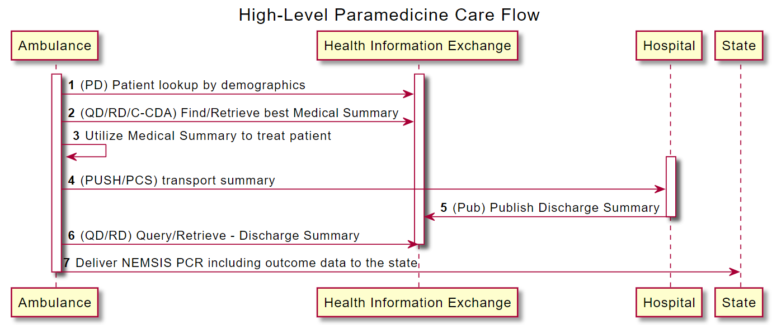
EMS-to-Hospital Information Flow

Slide 8
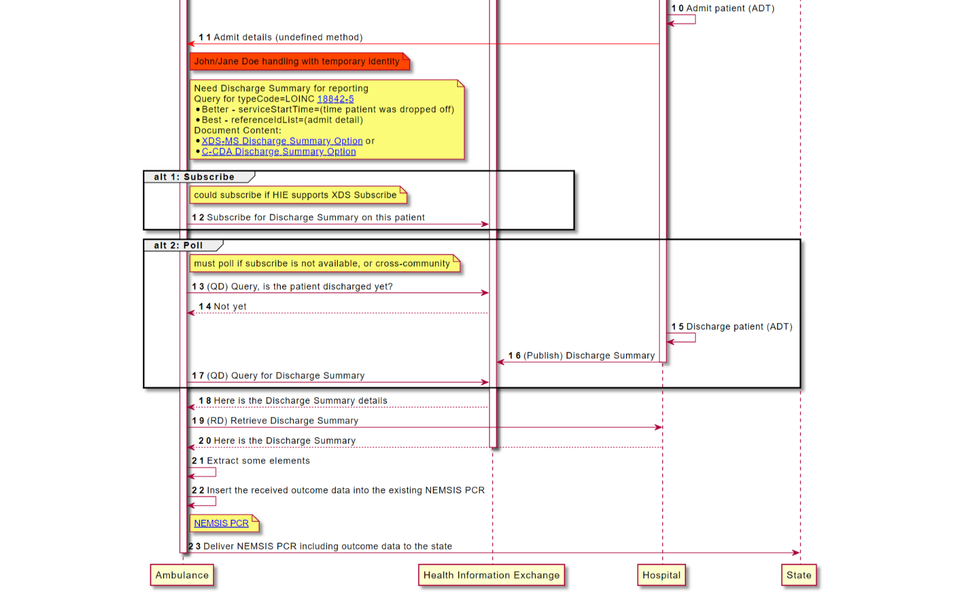

Slide 9
Content Standards
IHE Cross-Enterprise Sharing of Medical Summaries (XDS-MS): Discharge Summary
HL7 Consolidated CDA (C-CDA): Discharge Summary
HL7 v2 Admit-Discharge-Transfer (ADT)

Slide 10
Discussion
Kno2
Wisconsin Statewide Health Information Network (WISHIN)
RWJBarnabas Health & ZOLL
San Diego Health Connect (SDHC)
Texas Health Services Administration (THSA)

Slide 11
Outcomes Data
September 2023
Matt Becker, VP of Interoperability

Slide 12
Connectivity Strategy
Standards-based exchange
National networks/frameworks – multi-state arrangements
Breadth/depth of information

Slide 13
History of EMS Support
Prioritized EMS Connectivity for nearly a decade
Push (Direct), Pull (Carequality)
Support most use cases
911
PCR transmission
Community paramedics
Treatment information
Outcomes information
Framework policy
Wrote, drove, and helped publish Carequality exception for EMS
Continuing to push for outcomes support and broader data policy

Slide 14
Outcomes Data
Part of overall connectivity strategy
Working at scale
Vendors
Hospital systems
Available to all once available to one
Data
Discharge summary and patient-level C-CDA
Past encounter potentially also available

Slide 15
Outcomes Data – Next Steps
Industry awareness
Ease of implementation
Hospital “resource” pushback

Slide 16
Hospital Interoperability Task Force meeting 2023sept14

Slide 17
RWJBarnabas Health Mobile Health
Hospital Based EMS System
55 BLS Units
35 ALS Units
7 Critical Care Transport Units
1 Rotor Wing Air Medical Unit
12 Acute Care Hospitals across New Jersey

Slide 18
Original State (pre-2015)
Single ADT push of demographics following full registration in All Scripts Sunrise Clinical Manager EMR
Single Returned Document Push utilizing MDM-Linked document

Slide 19
Goals of Expansion (2019)
Link to all hospital EMR platforms
Import of EMS record to hospital EMR
All demographic updates
Disposition and Diagnosis Information to EMS Record
Internal Transfer (limited subset)
Notes:
All patient admits and discharges are processed to allow for interfacility charts to be linked
Only patient’s listed at registration as coming by ambulance have internal transfer information shared

Slide 20
Current/Developed State
Connections Developed with:
EPIC
Cerner
Allscripts Sunrise Clinical Manager
Rhapsody Interface Engine facilitates interconnectivity with disparate hospital EMR’s
Hyland OnBase Facilitates imbedded PDF to not ADT hospitals

Slide 21
ADT Messages
A01 - Patient Admit/Visit
A02 - Patient Transfer
A03 - Patient Discharge
A04 - Patient Registration
A05 - Patient Pre-Admission
A06 – Change of Outpatient to Inpatient
A08 - Patient Information Update

Slide 22
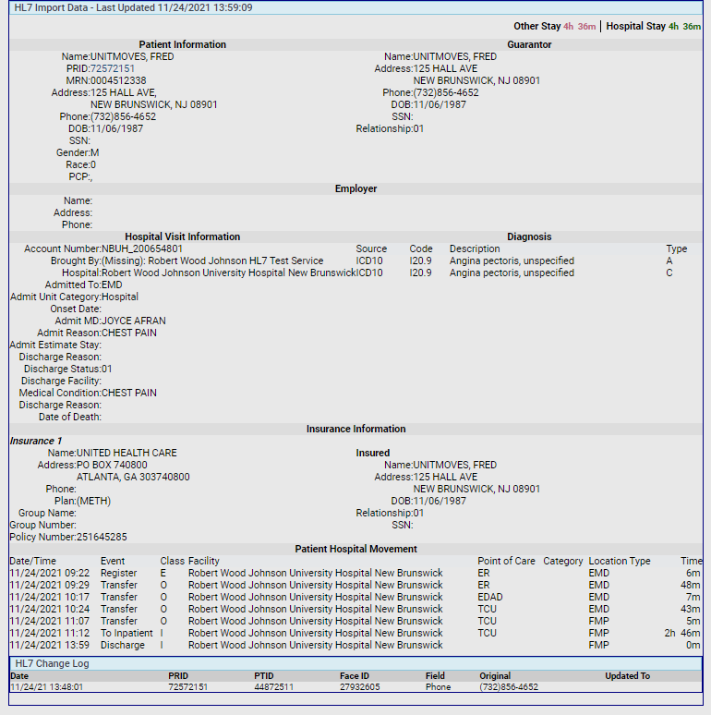
Administrator View

Slide 23
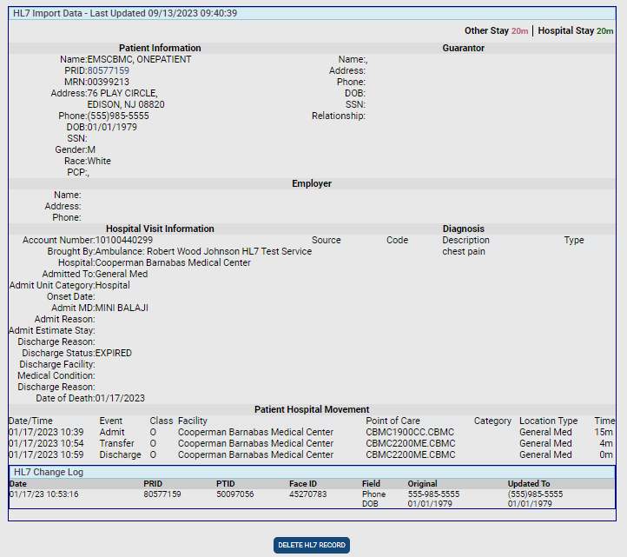
Backend View

Slide 24
Monthly Statistics

Slide 25

Did We Answer Today’s Questions?
What standards and profiles are used for the hospital-outcomes-to-EMS phase of the interoperability workflow?
What resources are needed to help software transform data into NEMSIS format?
What barriers disrupt the outcome data flow?
Notes:
Give link to survey in chat:
https://forms.office.com/r/Z1ER9MqctE

Slide 26
Next Steps
Survey for today’s task force call
Task Force Email Group
groups.google.com/g/ems-task-force
Github Repository and Wiki (includes link to sequence diagram)
github.com/IHE/EMS
October 12 Task Force Topic: Patient history to EMS
Notes:
October 12 Task Force topic: Patient history to EMS

